Slide 1
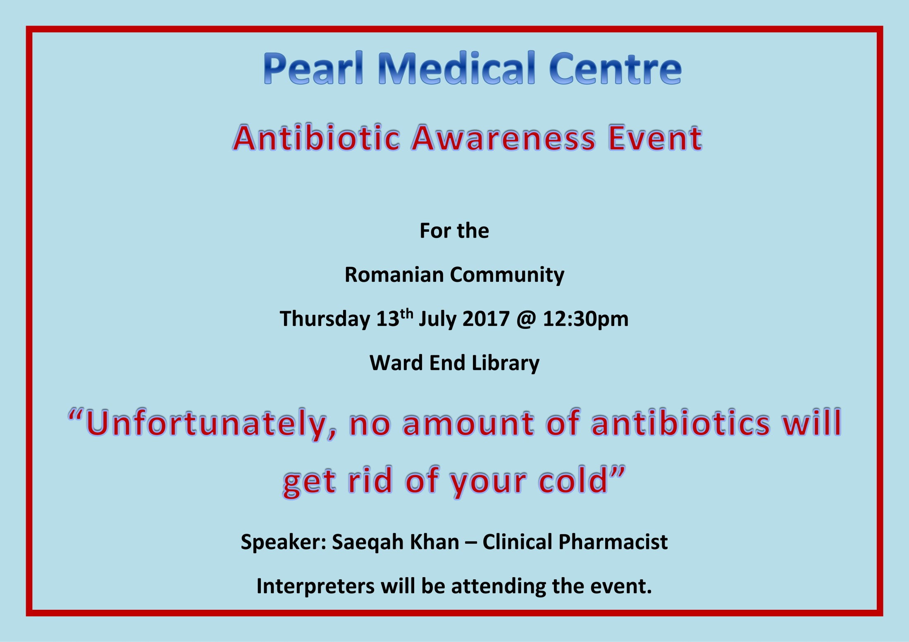
Pearl Medical Practice
Washwood Heath
Birmingham South Central CCG

Slide 2
What are antibiotics?
Antibiotics are important medicines used to treat infections caused by bacteria e.g. amoxicillin, erythromycin etc.
Bacteria can adapt and ﬁnd ways to survive the effects of an antibiotic. They become "antibiotic resistant", meaning that the antibiotic no longer works.
The more we use antibiotics, the greater the chance that bacteria will become resistant to them so that they no longer work on our infections.

Slide 3
What do patients expect antibiotics for?
All colds and most coughs and sore throats are caused by viruses and generally these will get better on their own.
Antibiotics do not work against infections caused by viruses. Viral infections are also much more common than bacterial infections.
Notes:
Seen through these changes – some challenging times for patients and staff alike.
Most notable in last 12 months – expand bkgnd – but last 5m more positive – hard work to make up for 18+months on significant changs/diffiuculties

Slide 4
So when will I be prescribed antibiotics?
Antibiotics should only be taken when prescribed by a health professional. Your doctor will only prescribe antibiotics when you need them, for example for a kidney infection or pneumonia.
Antibiotics may be lifesaving for infections such as meningitis. By not using them unnecessarily, they're more likely to work when we do need them.
Notes:
Seen through these changes – some challenging times for patients and staff alike.
Most notable in last 12 months – expand bkgnd – but last 5m more positive – hard work to make up for 18+months on significant changs/diffiuculties

Slide 5
What are the problems with antibiotics
Allergic reactions e.g. rash or wheezing are experienced by 1 in 15 people
Side effects such as diarrhoea, nausea, vomiting or thrush experienced by 1 in 10 people.
Antibiotic resistance (as antibiotics are losing their effectiveness at an increasing rate)
Some of the above mentioned problems are so serious that they may result in hospital admission
Notes:
Seen through these changes – some challenging times for patients and staff alike.
Most notable in last 12 months – expand bkgnd – but last 5m more positive – hard work to make up for 18+months on significant changs/diffiuculties

Slide 6
Why is antibiotic resistance relevant to you?
Antibiotic resistance is an everyday problem in all hospitals across England and Europe.
Without effective antibiotics many routine treatment will become increasingly dangerous.
Setting broken bones, basic operations, even chemotherapy and animal health all rely on access to antibiotics that work.
Notes:
Seen through these changes – some challenging times for patients and staff alike.
Most notable in last 12 months – expand bkgnd – but last 5m more positive – hard work to make up for 18+months on significant changs/diffiuculties

Slide 7
What can I do about antibiotic resistance?
Don’t ask for antibiotics routinely for coughs and colds.
Consider alternatives by asking your GP or pharmacist about over-the-counter remedies that can help in the first instance.
Take plenty of fluids and have rest. Take paracetamol if necessary.
You should use antibiotics only when it’s appropriate to do so. Take antibiotics exactly as prescribed. Do not skip doses take at regular intervals and never save them for future use and never share them with others.
Notes:
Seen through these changes – some challenging times for patients and staff alike.
Most notable in last 12 months – expand bkgnd – but last 5m more positive – hard work to make up for 18+months on significant changs/diffiuculties

Slide 8
Antibiotic resistance in numbers
25,000 die each year across Europe from infections resistant to antibiotic
10% of sore throats and 20% of acute sinusitis benefit from antibiotic treatment but the prescription rates are much higher than this
€1.5 billion is the annual EU wide cost of healthcare expenses and lost productivity due to antibiotic resistant bacteria
Notes:
Seen through these changes – some challenging times for patients and staff alike.
Most notable in last 12 months – expand bkgnd – but last 5m more positive – hard work to make up for 18+months on significant changs/diffiuculties

Slide 9
Thank you
Q& A

